Slide 1

Advancing practice in the care of people with dementia

Slide 2
Session 4
Treatment and intervention options 2
Learning outcomes:
Demonstrate knowledge relating to responses to behavioural and psychological symptoms of dementia
Demonstrate knowledge relating to therapeutic interventions in a number of clinical areas

Slide 3

Care considerations
Behavioural and psychological symptoms of dementia (BPSD)
Falls
Pain
Nutrition
Continence
Personal care
Sleep
Palliation

Slide 4
Behavioural and Psychological Symptoms of Dementia (BPSD)
‘symptoms of disturbed perception, thought content, mood, behaviour frequently occurring in persons with dementia’
International Psychogeriatric Association; 2002

Slide 5
BPSD
Common- affect up to 90% of people with dementia
Examples include: wandering, aggression, agitation, apathy, hoarding, anxiety
Increases carer burden
Legal and safety issues

Slide 6
BPSD
Impacts on:
  Functional status
  Prognosis
  Admission to residential care
  Care staff
  Hospital length of stay
Language of BPSD
  Problem behaviours
  Challenging behaviours
  Behaviours of concern
  Unmet needs behaviours
  Needs Driven Behaviours
  BPSD

Slide 7
Activity
Discuss the terminology surrounding BPSD in terms of its appropriateness and impact on the person, family carers and care staff.
Which do you prefer and why?

Slide 8
Principles of behaviour management
Psychosocial/non-pharmacological approach
Identify the factors behind the behaviour change
Develop individualised strategies based on assessment

Slide 9
Advantages of Non-Pharmacological Interventions in BPSD
Recognises rather than masks the underlying needs being communicated by the behaviour
Less limitations than pharmacological management, i.e. side effects, drug interactions
Practical and relatively in-expensive
Enhances carer attitudes towards care recipients with BPSD compared to pharmacological approach

Slide 10
Behaviour assessment
Establish the level of risk that the behaviour presents to the person and to others;
Provide a clear description of the behaviour, including the frequency, severity and triggers;
Gather information about the person: their characteristics, life history, diagnosis and support needs;
Gather information about the carer: characteristics, communication approach, relationship factors and stress threshold;
Critically review the care environment: physical, social, cultural, emotional and spiritual;
Rule out medical causes.
(Dementia Behaviour Management Advisory Service)

Slide 11
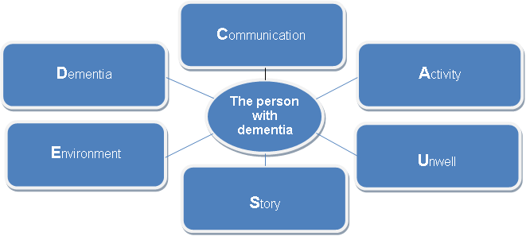
Team Concept Mapping
Brings assessment data together using the CAUSED Model.
(Aberdeen et al, 2010)

Slide 12

Team Concept Mapping steps
Initiate
Implement
Evaluate and review care
Act on outcomes

Slide 13

Pharmacological management of BPSD
Second-line approach
Only where behaviours cause severe distress or harm
Antidepressants, analgesics, antipsychotics
Target right drug to right symptom

Slide 14
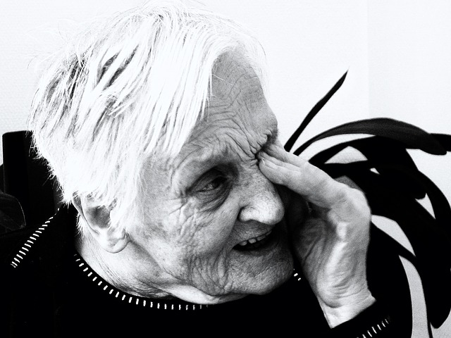
BPSD that may respond to medication
Anxiety
Depressive symptoms
Manic-like symptoms
Persistent and distressing hallucinations/delusions
Persistent and severe verbal and physical aggression

Slide 15
BPSD that will not respond to medication
Wandering
Socially inappropriate urination/ defaecation
Socially inappropriate dressing/undressing
Repetitive activities (perseveration) or vocalisation
Hiding/hoarding
Eating inedibles

Slide 16

Falls
Higher risk in people with dementia
Interventions centre on modification of the environment
Minimising risks
Reducing intrinsic factors wherever possible.
Can manifest as disturbed sleep or behavioural symptoms
Assessment
Treatment should include non-pharmacological intervention

Slide 17
Nutrition
Compromised by dementia symptoms
Loss of interest in food
May have extreme hunger and crave sweets
Management of altered cognition
  Exclude other medical causes—acute illness, depression
  Review medications as these may be affecting appetite or causing nausea
  Check oral health

Slide 18

Interventions
Finger foods
Provide healthy snacks
Small frequent meals
Keep fluids visible throughout the day
Uncomplicated table settings
Unpatterned crockery
Serve one dish at a time
Keep the environment calm and quiet at mealtimes

Slide 19
Continence
As cognition declines, people with dementia are more susceptible to both urinary and faecal incontinence
Decreased ability to recognise need, respond to sensation and locate toilet
Interventions
Continence assessment-usual pattern
Observe for cues: agitation, fidgeting
Timed toileting
Prompted voiding
Fluid intake
Clothing
Make toilet easily recognisable

Slide 20
Personal care
Decreasing ability to attend to personal hygiene, grooming and dressing
Resistance to care
Interventions
Ascertain and maintain person’s usual routines and habits
Be aware of personal history

Slide 21
Sleep
Sleep disturbances include:
Early wakening
Night time wandering and restlessness
Reversed day-night cycle
Disorientation to time
Interventions
Medical assessment
  exclude reversible causes
  management of co-existing morbidities
Medication review, particularly review of diuretic regimes
Environmental assessment focusing on room temperature and lighting
Limit caffeinated drinks
Encourage exercise – physical and mental

Slide 22
Palliation
Dementia now being recognised as a terminal disease
A palliative approach is an important clinical and social issue
Optimise quality of life
Limit disability
Treatment of acute episodes
Advance care planning

