Slide 1

Advancing practice in the care of people with dementia

Slide 3

Learning outcomes:
On completion participants will:
be able to define what is meant by dementia
have insight into the different types of dementia
be able to describe the symptoms of dementia
describe options for treatment and interventions
be able to discuss the factors which contribute to Behavioural and Psychological Symptoms of Dementia (BPSD)
understand how to respond to Behavioural and Psychological Symptoms of Dementia (BPSD)
be able to discuss the benefits of person-centred approaches to the care of people with dementia
be able to describe how the physical environment can support quality care for people with dementia
implement strategies to promote best practice care for people with dementia

Slide 4
Session 1
Overview of dementia
Learning outcomes:
Have knowledge of the basic functions of the brain
Differentiate the effects of normal and pathological ageing on the brain
Have knowledge of what dementia is and the different types of dementia

Slide 5
A worldwide dementia epidemic
More than 35,000,000 people living with dementia
The total number of people with dementia is projected to almost double every 20 years, to 65.7 million in 2030 and 115.4 million in 2050
The current global costs for dealing with dementia are estimated to be more than US$ 600 billion per year
Dementia is overwhelming for the carers and adequate support is required for them from the health, social, financial and legal systems
(World Health Organization and Alzheimer’s Disease International)

Slide 6
In Australia
In 2014, it was estimated that 330,00 Australians were living with dementia.
(Alzheimer’s Australia, 2014)
It is anticipated that by 2050 this number will almost treble.
(Deloitte Access Economics, 2011)

Slide 7
Meaning:
Dementia imposes economic and social burdens
  direct (medical and social care)
  indirect costs (unpaid care giving by families and friends, impact on carer health)
Urgent actions are needed including:
  promoting a dementia friendly society globally
  making dementia a public health and social care priority worldwide
  improving attitudes to, and understanding of, dementia
  investing in health and social systems to improve care and services for people with dementia and their carers
  increasing the priority given to dementia in the research agenda.
  (World Health Organization and Alzheimer’s Disease International)

Slide 8
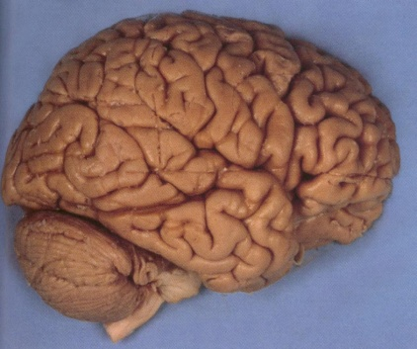
The brain, cognition and age related change
Our most complex and powerful organ
Weighs only about 1.4kg
Essential to life and being

Slide 9
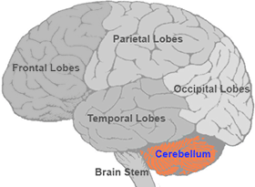
Structure of the brain
The cerebrum: divided into lobes: each responsible for specific functions
The cerebellum : coordination and balance.
The brain stem connects the brain to the spinal cord. It controls automatic functions:
breathing
blood pressure.
heart rate
digestion

Slide 10
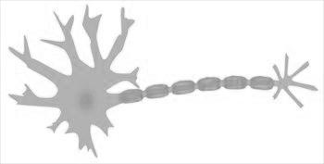

Neurons
100 billion neurons, with
branches that connect at
more than 100 trillion
points.

Slide 11
Cognition
“The abilities that enable us to think,
which includes the ability to concentrate
(pay attention), remember and learn”
“Includes executive functions such as the
ability to plan, manipulate information,
initiate and terminate activities and recognise errors”
(Unsworth, 1999)

Slide 12
Normal age related changes to cognition
Generalised decline in speed of processing - accuracy of response is not affected
Slower and more cue dependant memory performance
Learning capacity is not impaired
No interference with ADLs, social or occupational functioning
Decrease in learning speed and recall - If given extra time to complete the task intellectual functioning is adequate
No alteration to insight
Normal language and praxis
(Unsworth, C.(1999). Cognitive and perceptual dysfunction: a clinical reasoning approach to evaluation and intervention. Philadelphia:F.A.Davis.)

Slide 13
Dementia explained
Dementia refers to the symptoms of a large group of illnesses which cause a progressive decline in a person’s mental functioning.
It is a broad term that describes loss of memory, intellect, rationality, social skills and normal emotional reactions. (www.betterhealth.vic.gove.au)
Causes loss of intellectual abilities
Impacts on social functioning
Impacts on occupational function
It is NOT normal ageing

Slide 14
New terminology
Major neurocognitive disorder
  Stigma
  Younger people
Acknowledges that ‘dementia’ will continue to be used

Slide 15

Impact of dementia: the personal
journey
Memory – short then long term
Emotions - Emotional disturbance
Language – word finding
Abstract thought and judgement
Orientation
Activities of daily living, planning and recognition problems
Behaviour
Continence
Nutrition
Mobility
Death

Slide 16
Types of dementia : Alzheimer’s Disease
Most common form: 75% of all dementias
Usually post 65 years of age
Brain cells shrink or disappear, neurofibrillary tangles and plaques disrupt messages in the brain

Slide 17
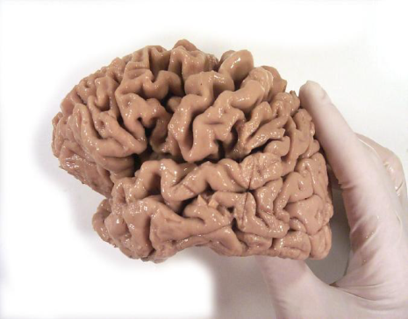

Slide 18
Vascular dementia:
associated with problems of circulation of blood to the
brain e.g. strokes, artery disease, hypertension
Mixed dementia:
Alzheimer's and vascular components
Dementia with Lewy Bodies:
degeneration or death of nerve cells in the brain
spherical structures called Lewy Bodies inside cells
visual hallucinations, parkinsonism, fluctuating mental state

Slide 19
Fronto-temporal dementia:
usually 40 – 65 years of age
memory intact in early stages
executive dysfunction
lack of insight
Other dementias:
AIDS related, Alcohol related
Huntington's / CJD

Slide 20
Younger onset dementia
The term is used to describe any form of dementia diagnosed in people under the age of 65.
People with younger onset dementia tend to:
be affected by the less common forms of dementia
present with more challenging behaviours
progress at a faster rate

Slide 21
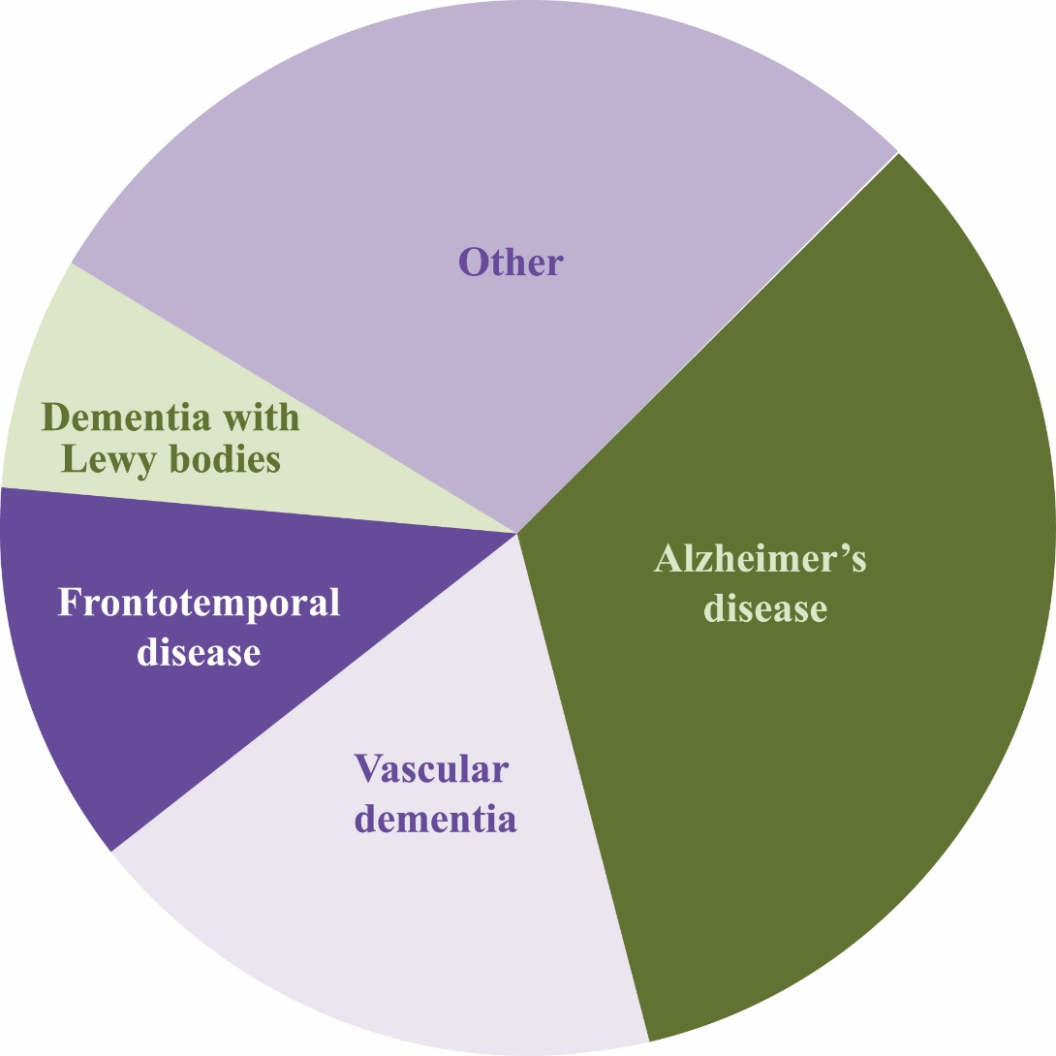
Types of younger onset dementia

Slide 22
Younger onset dementia: issues
Diagnosis
Relationships
Children
Employment
Finances
Plans for the future
Grief and Loss
Driving
Access to appropriate services

Slide 23
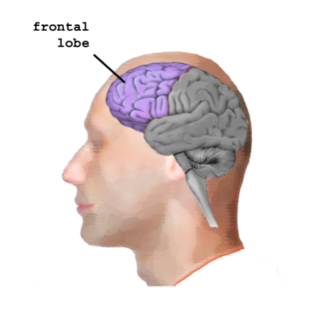
Manifestation of dementia: Frontal lobe
The so-called executive lobe, and site of self:
Judgment
Inhibition and emotional response
Initiation
Personality and sense of self
Memory of motor habits or plans
Language – usage or motor elements

Slide 24
Damage to the frontal lobe causes:
Impaired planning and problem-solving
Distractibility with inability to task focus
Behaviour disorders
Difficulty in learning new information
Lack of inhibition
Contralateral hemiplegia, hemiparesis
Expressive difficulties/motor aphasia

Slide 25
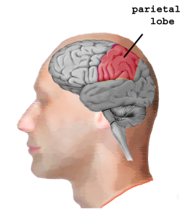
Parietal lobe
  Visual and tactile
  Perception processing and integration of sensory input
Body orientation
Damage to the parietal lobe causes:
Difficulties with writing, reading and naming objects
Inability to discriminate between sensory stimuli
Inability to locate and recognise parts of the body (neglect)
Reduced awareness of environment space

Slide 26
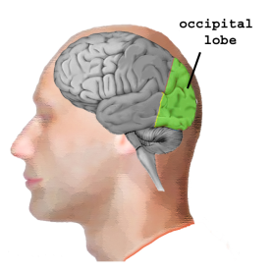
Occipital Lobe
Visual perception
primary visual perception and association areas
Damage to the occipital lobe causes:
Visual defects – reduction in opposite visual field
Loss of ability to recognise objects in opposite field

Slide 27
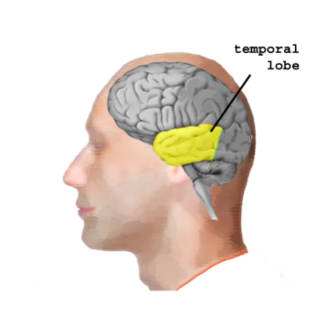
Temporal lobe
  Primary organisation of sensory input (auditory perception)
Language: receptive speech
Memory: short and long-term information retrieval
Damage to the temporal lobe causes:
Memory – difficulties in retrieval of information
Receptive/sensory aphasia (e.g. Wernicke’s)
Impaired concentration
Aggression, agitation and irritability including altered sexual interest

Slide 28
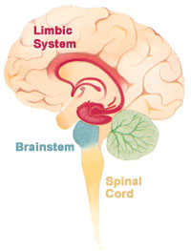
Limbic system
Above the brainstem and within the cerebrum
Connects areas responsible for high and low functions
Group of structures controlling
  Emotions,
  Memories, and
  Arousal (stimulation)
Hippocampus
  Part of the limbic system
  Storage and retrieval of memories
Damage to the limbic system causes:
Memory impairment
Emotional disturbances
Behavioural disturbances

Slide 29
Dementia risk factors
Age
Lifestyle
  Alcohol and drug abuse
  Obesity
  Cardiovascular disease
  Diabetes (type 2)
Genetics
  Susceptibility genes (APOEὲ4)
  Autosomal dominant genes
Other factors
  Huntington’s disease
  Down syndrome
  Parkinson’s disease
  Head injury
  Toxins

Slide 30
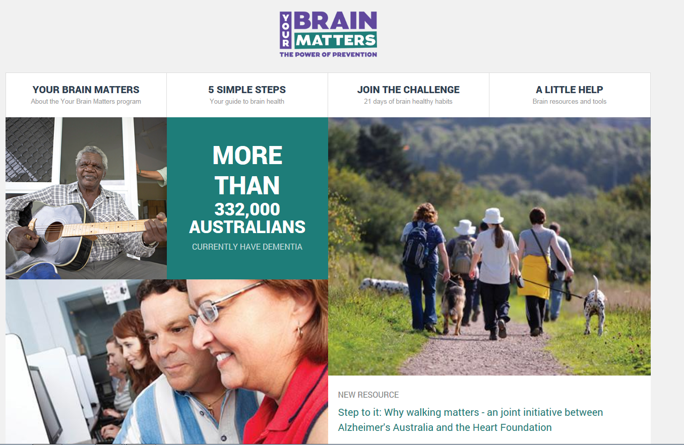
Risk reduction
Look after brain, body and heart
Lifestyle factors- reduce cardiovascular risk
  Physical activity
  “Mediterranean diet”
  Socially active
  Challenge your brain
  Heart health

